Slide 1

Tech Flow Space
Blockchain Course -Session 3

Slide 2
Bitcoin contd..

Slide 3
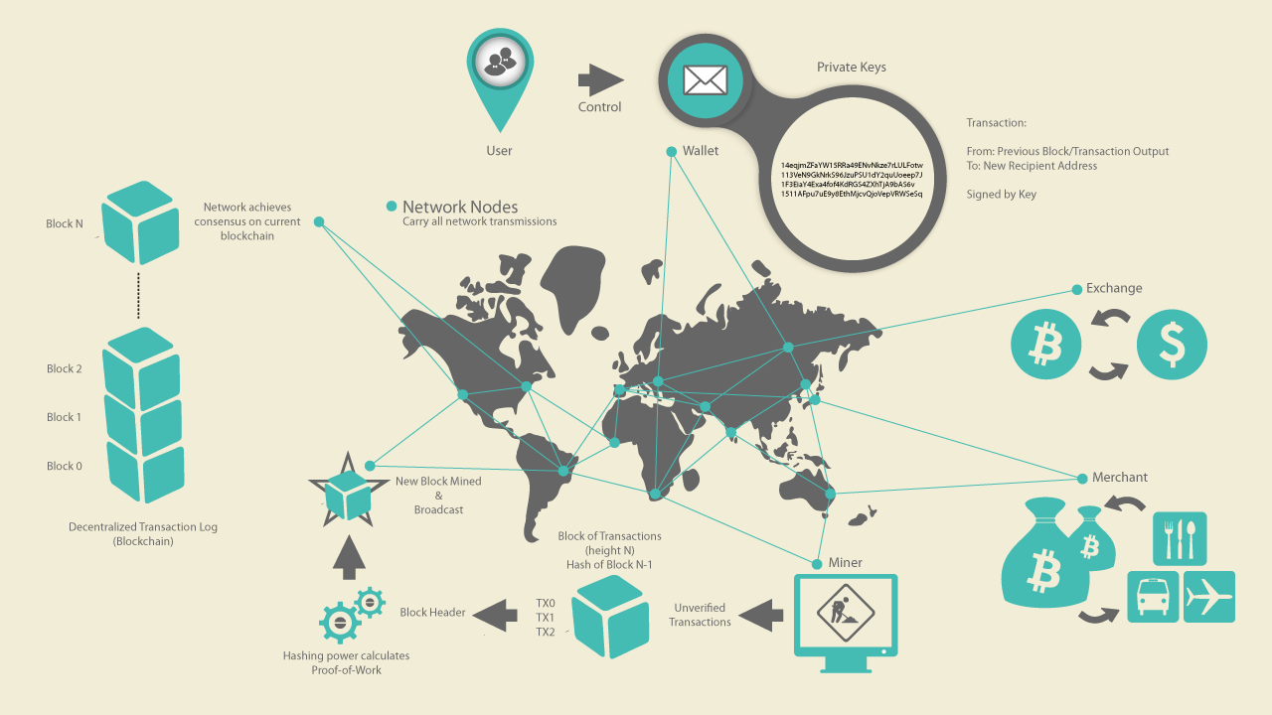

Slide 4
So how does all this work!!
Lets deep dive into some of the basic entities we discussed in previous session.

Slide 5
Keys And Addresses:
Bitcoin is based on Cryptography
Cryptography : branch of mathematics used in computer security
Not just encryption - bitcoin doesn’t have encryption!
Provides tools to -
prove knowledge of a secret without revealing the secret - digital signature
Authenticity of data - fingerprint or hash.

Slide 6
Public Priavate Keys
Public Key : where someone can send you bitcoin
Private Key : how you can spend that bitcoin
Address : More user friendly version of public key for someone to send you money

Slide 7
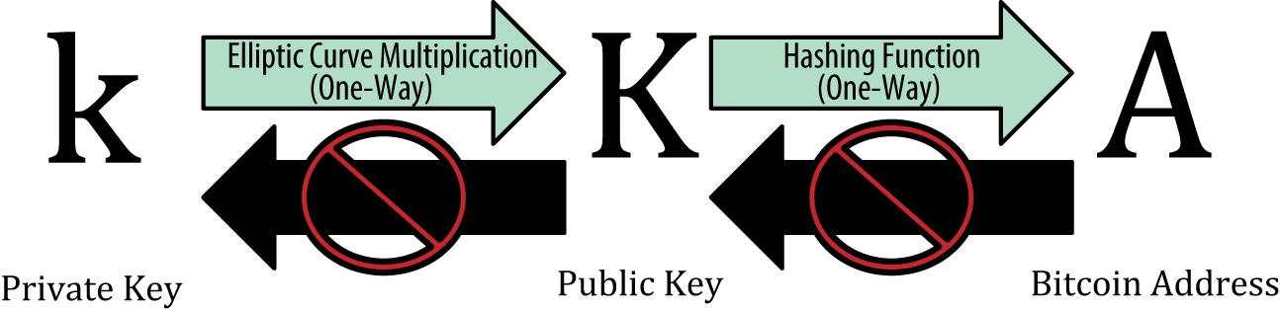
Private and Public Keys

Slide 8
Public Priavate Keys
Private key (k) - 256 bit random number -
You can coin toss 256 times and write 0 or 1 for head and tail to get a private key
2²⁵⁶ key space is 10⁷⁷ digit number.
Visible universe estimated to have 10⁸⁸ atoms
Enough private keys to give every atom in universe
Collision is extremely rare if a good source of entropy is used
This is why good random number generator is very important

Slide 9
Public Priavate Keys
Public key (K) : use elliptic curve multiplication, a one-way cryptographic function on private key to get public key
A point (x and y coordinate) on an elliptic curve that satisfies elliptic curve equation
K = k *G ( K is public key, k is private key and G constant point called generator point)
One way function - easy to get K from k but impossible to get k from K
Bitcoin and ethereum uses secp256k1 curve with a fixed G.
Therefore given a k will always result in same K

Slide 10
Public Priavate Keys
Address (A) : use one-way cryptographic hash function on public key to get address
Address = Public key -> sha256 hash -> Ripemd160 hash -> Base58Check encoded
Base58Check - Creates a human readable string. For example removes 0OIl characters that look the same in some fonts

Slide 11
Key Pair Lab
Please follow steps on https://gitlab.com/techflowspace/tfs-blockchain-class-2019/tree/master/session-3 and run Bitcoin-keypair.js to generate private key , public key and address on a testnet.
Note: TestNet address generated are different from Mainnet so people don’t accidentally lose their bitcoin by sending it to wrong address.

Slide 12
Public Priavate Keys
Examples:
public key: 036a09a42ea81155c562c21095e86a8b78226aef281fab8b3077cbe2931d721cf5
private key (256 bit/ 64 bytes) : 5aecec44e13839d7f8ae5943991aa21c60c8f45aaa74f39fd78ee45626c5f27b
private key WIF:
cQdSzKvXUCnY4szGvojYdSaU1PrdymrceZzzcWL446t5CUtSMWHT
address: mmLoHeQPBuejwaNgNJ4umEefDH5fhmahVC

Slide 13
Wallets
Manages the creation of these private / public key and addresses.
Good wallet makes sure the private key it generates is random enough
It also queries the blockchain to show you transactions on those addresses in the blockchain
Creates transactions and broadcasts it when you want to spend your bitcoin

Slide 14
Transactions:
What the blockchain holds!!
Transaction life cycle
Transaction created - wallet or sdk
Propagate on network so all nodes and miners see it
Miner validates and includes in a block
Finally added to the blockchain (global ledger)

Slide 15
UTXO
Unspent Transaction Output
Bitcoin doesn’t maintain a balance at account or address level !!
Unlike your bank balance or event Ethereum balance on an address.
How much bitcoin one has is dependent on how much unspent transaction output there is on an address for which you have the private key to spend.
Instead of account balance there are transaction outputs

Slide 16
UTXO Contd.
When wallet shows balance -
It dectects UTXO in the blockchain for the addresses that it controls (i.e has the private keys for)
A wallet’s bitcoin "balance" is the sum of all UTXO that the wallet can spend
It could be scattered across hundreds of transactions in hundreds of blocks including the block no 2 !
Current block no on mainnet is around ~586700

Slide 17
Transaction Detail
So what comes first input or output ?
Its output as the coinbase txn just has UTXO.
Coinbase txn is the txn where bitcoin is created as a reward for generating a block.
Lets disect a transcation where Alice pays for Coffee to Bob ( From Mastering Bitcoin book)

Slide 18
Using explorer
https://live.blockcypher.com/btc/tx/0627052b6f28912f2703066a912ea577f2ce4da4caa5a5fbd8a57286c345c2f2/

Slide 19
Bitcoin ownership established using combination of
Private key
Public key
Address
Digital Signature

Slide 23
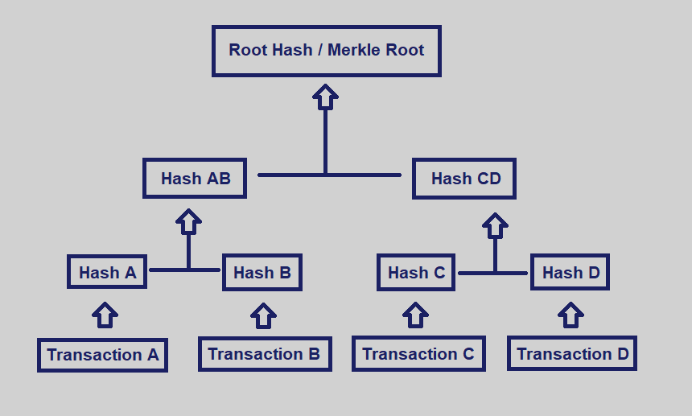
Merkle Tree:

Slide 24
Merkle Tree:
fundamental portion of blockchain technology
a structure that allows for efficient and secure verification of content
Each pairs of nodes are hashed in multiple level until only one node is left known as merkle root
Transaction hash at the bottom of the tree structure

Slide 25
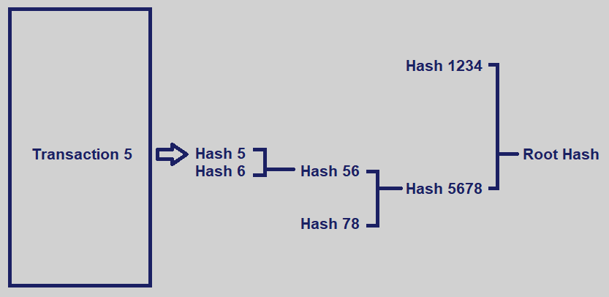
Merkle Tree contd.

Slide 26
Resources
Testnet faucet 1 : https://coinfaucet.eu/en/btc-testnet/
Testnet faucet 2 : https://tbtc.bitaps.com/
Learn me a bitcoin https://learnmeabitcoin.com/

